Slide 1
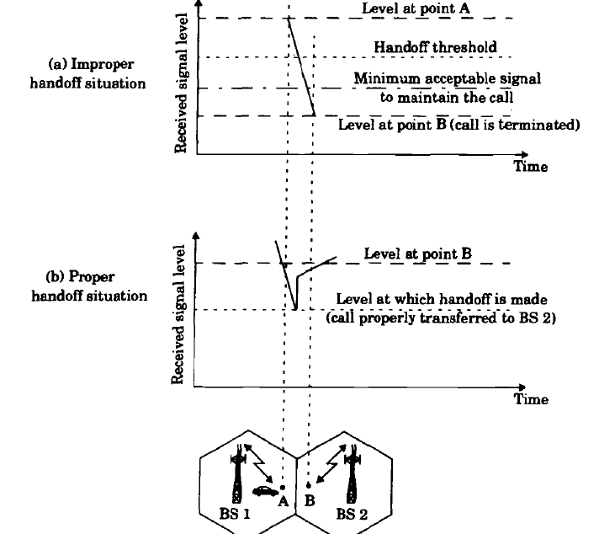
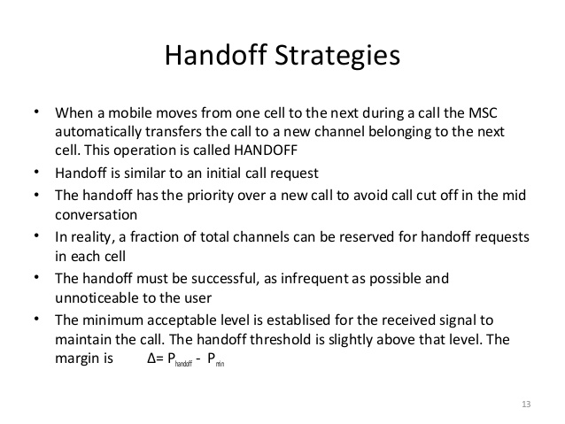
Handoff Strategies
Fig: Handoff Strategies
Courtesy to Theodore S. Rappaport
©2002, 1996 Prentice Hall PTR

Slide 2
Handoff Strategies contd..
In deciding when to handoff, it is important to ensure that the drop in the measured signal level is not due to momentary fading and that the mobile is actually moving away from the serving base station.
In order to ensure this, the base station monitors the signal level for a certain period of time before a handoff is initiated.
Running average measurement of signal strength should be optimized so that unnecessary handoffs are avoided, while ensuring that necessary handoffs are completed before a call is terminated due to poor signal level.

Slide 3
Handoff Strategies
Dwell Time: Time over which a call may be maintained with in a cell, with out Handoff.
First generation analog cellular systems
Base stations monitors the signal strength of all mobile users
MSC decides Handoff

Slide 4
Handoff Strategies
Present cellular systems
Mobile assist handoff (MAHO)
Mobile measures received power from neighbouring base station and reports to the serving base station.
Handover is fast
Computation load on MSC is reduced.

Slide 5
Prioritizing Handoffs
2 methods for giving priority to Handoff
Guard channel concept
Queuing of handoff

Slide 6
Prioritizing Handoffs
Guard channel -Fraction of the total available channels in a cell is reserved exclusively for handoff requests from ongoing calls which may be handed off into the cell.
Advantage:
Efficient spectrum utilization when dynamic channel assignment strategies are used which minimizes the number of required guard channels by efficient demand based allocation.
Disadvantage:
Reduction in the total traffic carried.
Fewer channels are allocated to originating calls.

Slide 7
Prioritizing Handoffs
Queuing of handoff
Decrease the probability of forced termination of a call due to lack of available channels.
Queuing of handoffs is possible due to a finite time interval between the time the received signal level drops below the handoff threshold and the time the call is terminated due to insufficient signal level.
Time delay and the size of the queue depends on the traffic of the particular service area.
Queuing does not guarantee a zero probability of forced termination.

Slide 8
Types of Handoff
Hard Handoff - Channel in the source cell is released and only then the channel in the target cell is engaged
- It is a break-before-make.
Soft Handoff - one in which the channel in the source cell is retained and used for a while in parallel with the channel in the target cell
-It is a make-before-break.

Slide 9
Summary
Handoff is necessary to keep call in progress as the mobile is moving from one cell to another cell.
Prioritizing the handoff is required so that fraction of the total available channels in a cell is reserved exclusively for handoff requests from ongoing calls which may be handed off into the cell.
Various ways of handoff like soft and hard handoff are implemented to provide handoff service.

